Slide 1
PROJECT TITLE
CAPSTONE PROJECT
Presented By:
1. Nihal S SRM Institute of Science and Technology Btech CSE AIML

Slide 2
OUTLINE
Problem Statement
Proposed System/Solution
System Development Approach
Algorithm & Deployment
Result (Output Image)
Conclusion
Future Scope
References

Slide 3
Problem Statement
Power System Fault Detection and Classification
Design a machine learning model to detect and classify different types of faults in a power distribution system. Using electrical measurement data (e.g., voltage and current phasors), the model should be able to distinguish between normal operating conditions and various fault conditions (such as line-to-ground, line-to-line, or three-phase faults). The objective is to enable rapid and accurate fault identification, which is crucial for maintaining power grid stability and reliability.

Slide 4
Proposed Solution
The proposed system aims to address the challenge of rapidly detecting and classifying different types of faults in a power distribution system using machine learning techniques. By leveraging electrical measurement data—such as voltage and current phasors—the solution enables timely identification of issues to maintain grid stability and reliability. The solution consists of the following components:
Data Collection:
Gather historical and simulated data on electrical parameters such as voltage and current phasors under both normal and various fault conditions.
Collect additional contextual information, such as operational status and grid configurations, to enhance classification accuracy.
Data Preprocessing:
Clean and preprocess the gathered data to handle missing values, outliers, and inconsistencies.
Perform feature engineering to extract relevant characteristics (e.g., phasor magnitudes and angles) that may impact fault detection.
Machine Learning Algorithm:
Implement a supervised machine learning algorithm, specifically Random Forest Classification, to detect and classify fault types based on electrical measurement patterns.
Consider incorporating operational factors and event logs to further improve classification accuracy.
Deployment:
Develop a user-friendly interface or application that allows real-time input of electrical measurement data and provides instant fault detection and classification results.
Deploy the solution on IBM Cloud using Watsonx.ai Studio to ensure scalability, reliability, and remote accessibility for grid operators.
Evaluation:
Assess the model’s performance using metrics such as Accuracy, Precision, and Recall for each fault class.
Continuously monitor and fine-tune the model based on feedback and performance in real operational scenarios.
The Random Forest Classification model achieved an accuracy score of 0.904, demonstrating strong performance in detecting and classifying various power system faults.

Slide 5
System Approach
Platform & Tools:
IBM Cloud Lite
Watsonx.ai Studio (for model development and deployment)
Key Libraries:
Python, scikit-learn, pandas, numpy, matplotlib
Hardware/Cloud Setup:
Model implemented and trained in IBM Watsonx.ai Studio environment for secure, scalable computation.
Data Requirements:
Input: Voltage and current phasor measurements.
Output: Fault status (normal, LG, LL, LLG, LLL, etc.).

Slide 6
Algorithm & Deployment
Algorithm Selection
Random Forest Classification: Chosen for its robustness and ability to handle complex, nonlinear relationships in electrical parameters.
Provides both fault detection (normal vs. fault) and classification (type of fault).
Implementation Steps:
Input data: Process raw electrical measurements, feature engineering (e.g., phasor magnitudes, angles).
Model trained with labeled events (normal and various fault scenarios).
Training process optimized with cross-validation and grid search for hyperparameter tuning.
Deployment:
The trained model is deployed on IBM Watsonx.ai Studio.
User interface/app enables operators to input real-time measurements and receive instant fault classification.
Integration with cloud ensures scalability, reliability, and remote access.

Slide 7
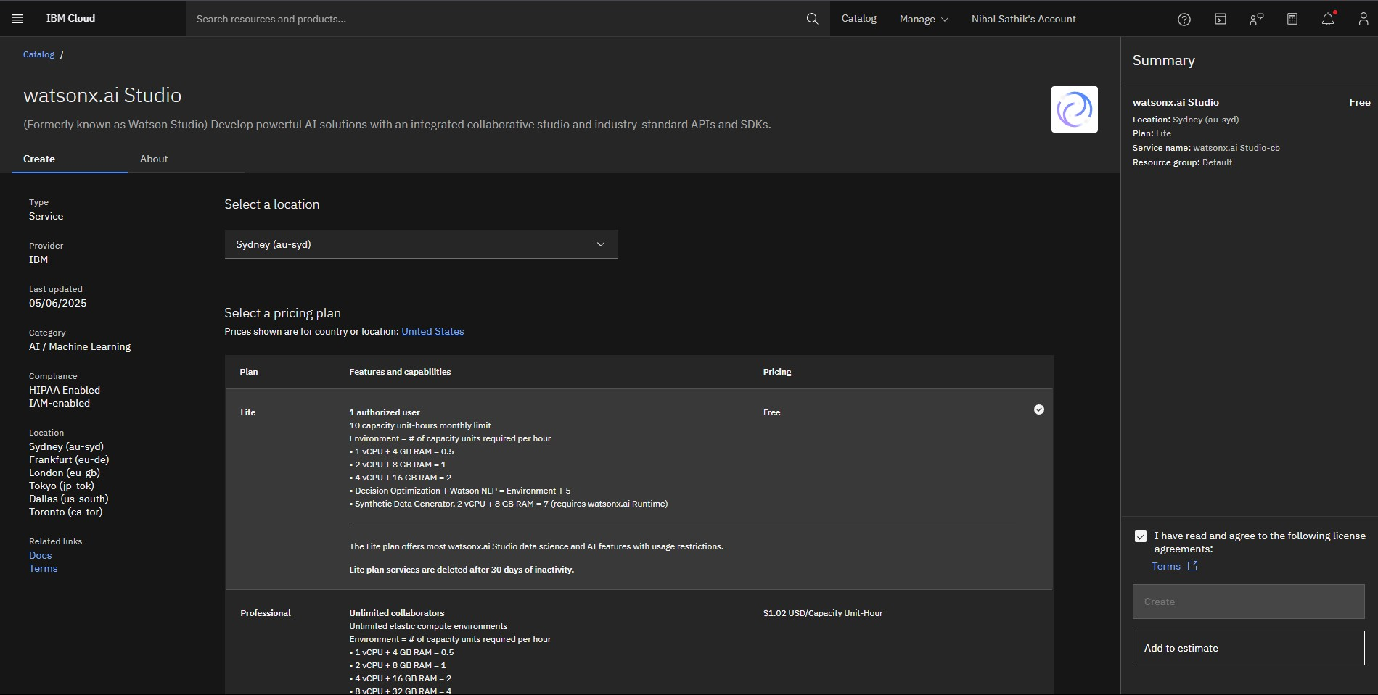
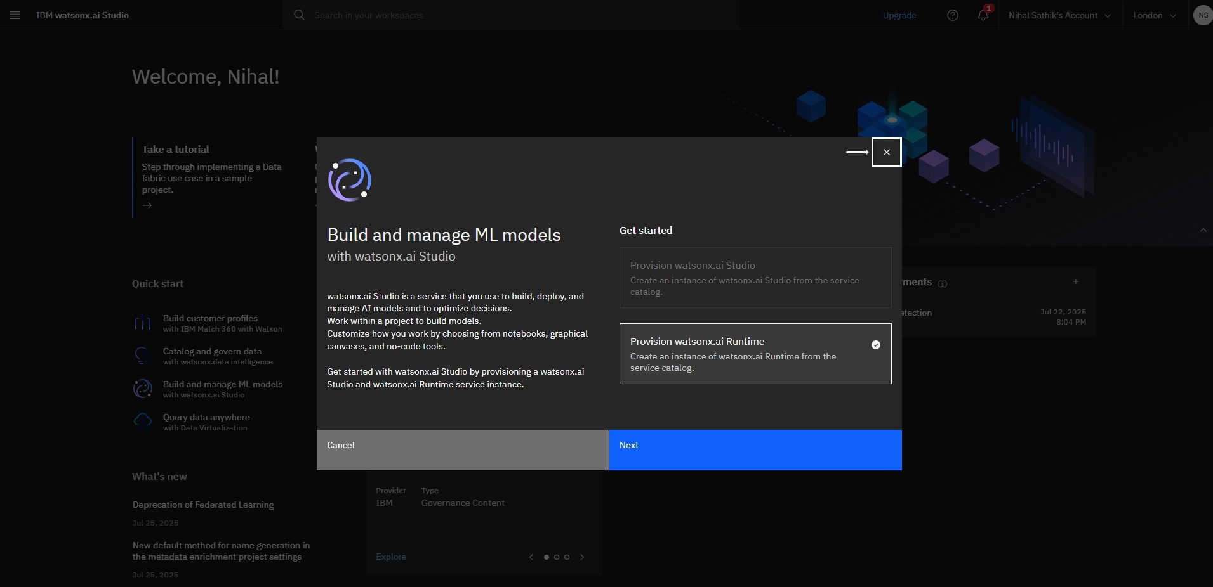
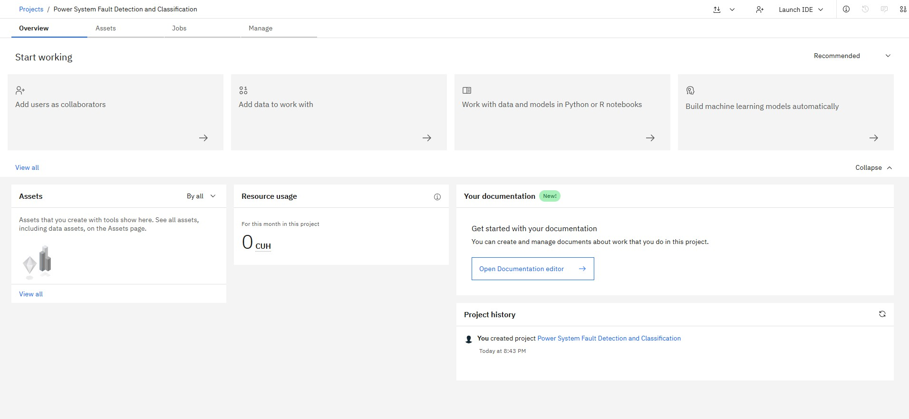
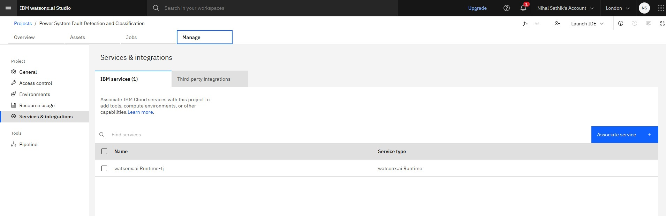
Result

Slide 8
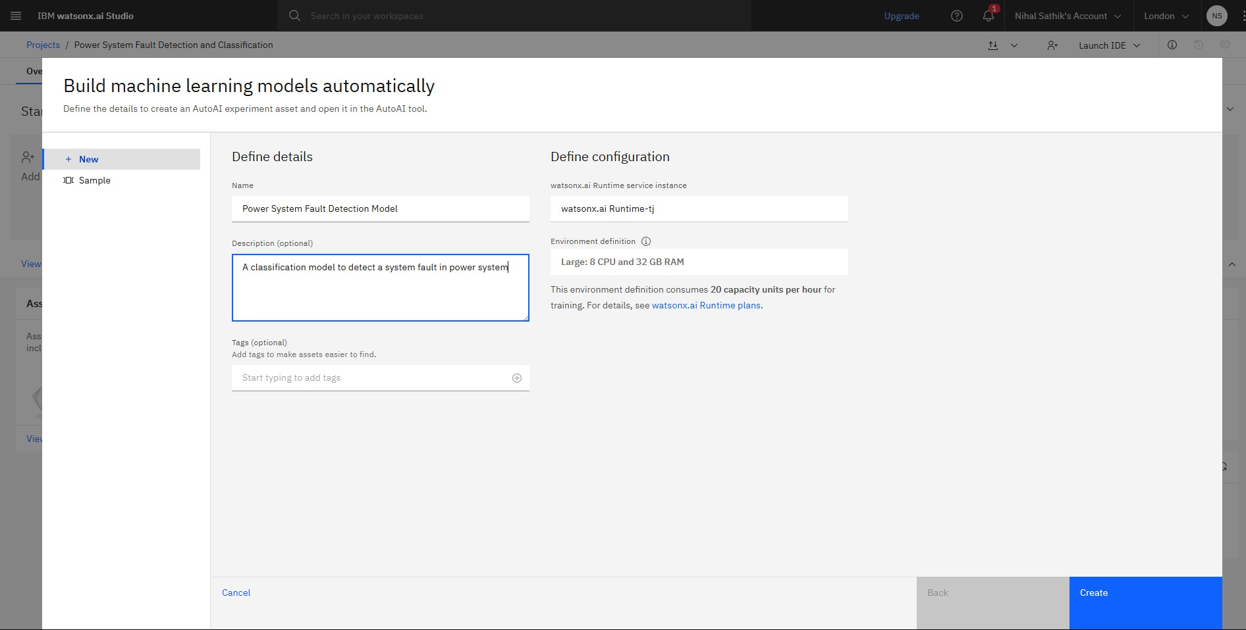
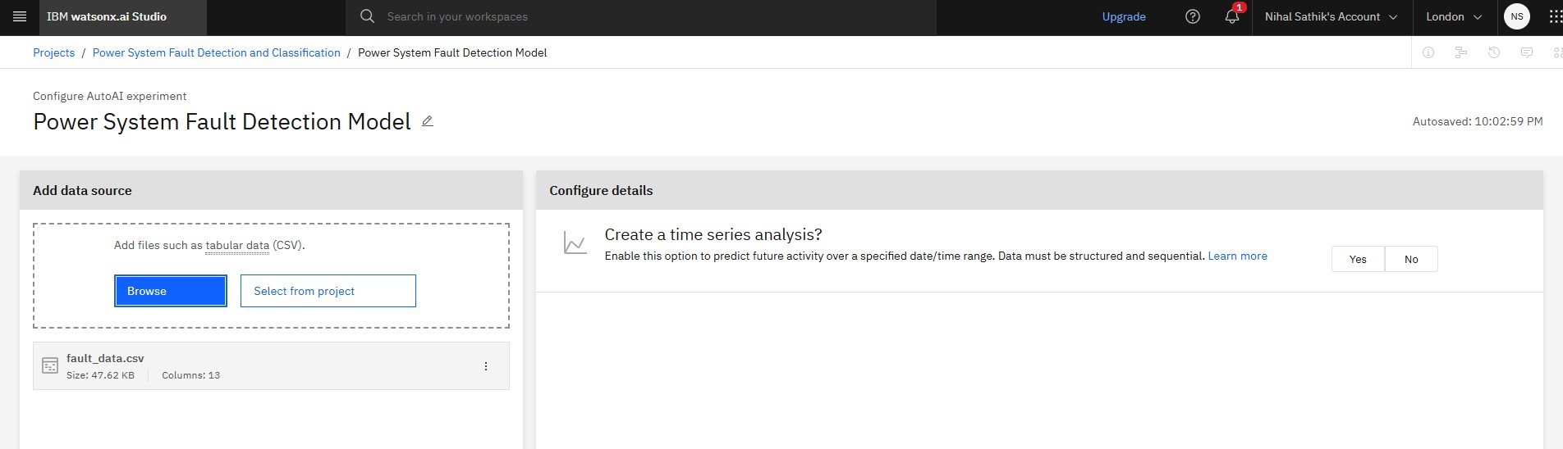
Result

Slide 9
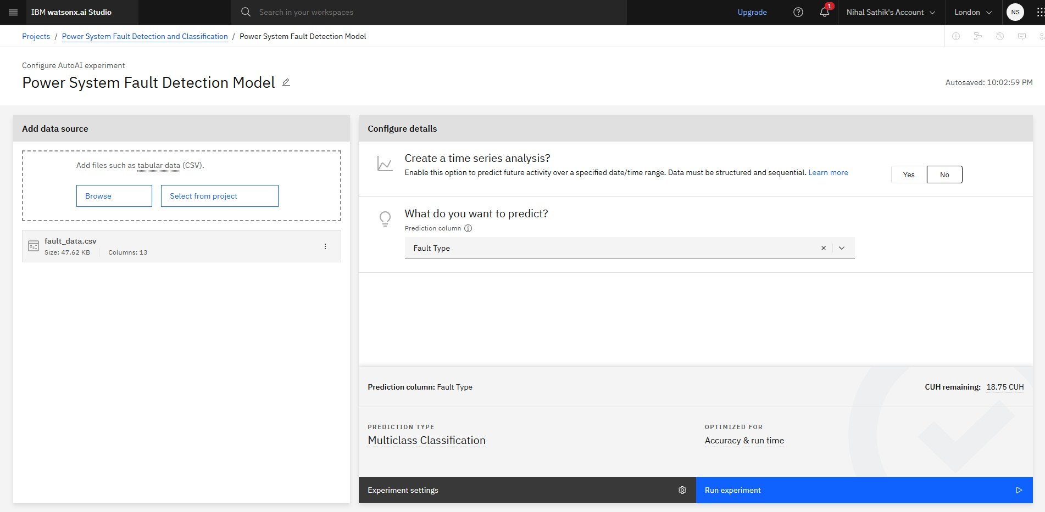
Result

Slide 10
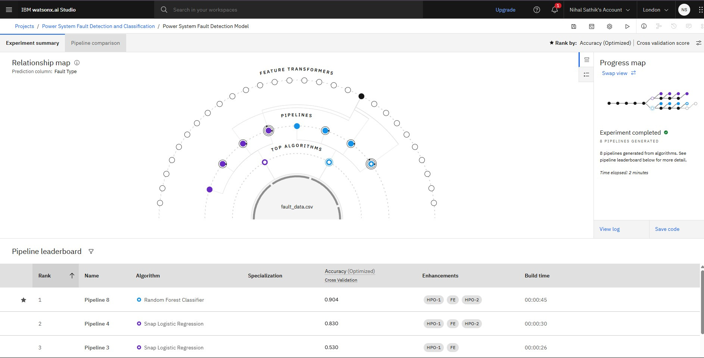
Result

Slide 11
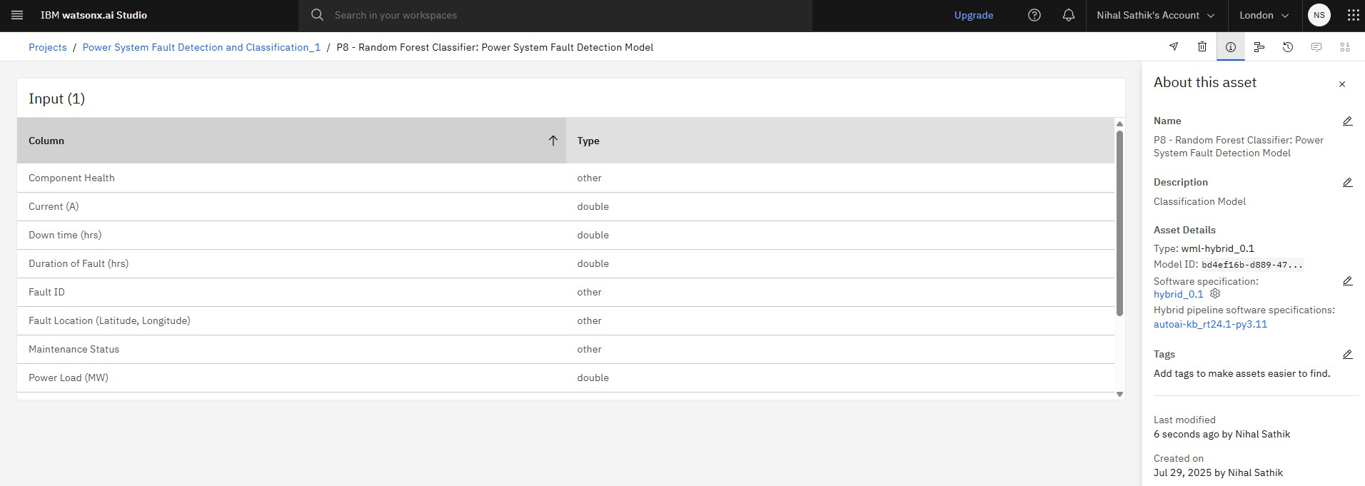
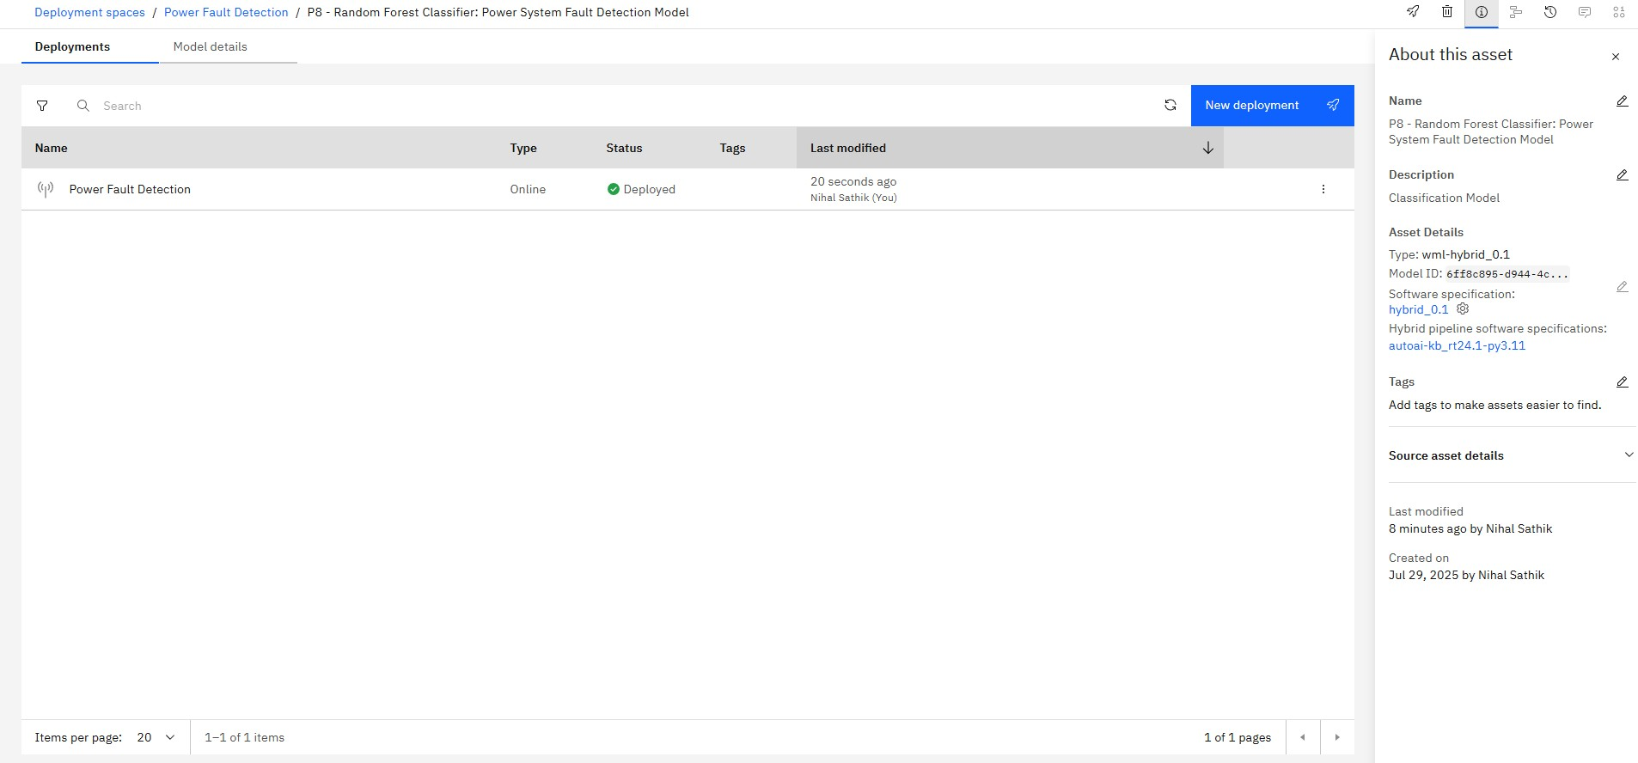
Result

Slide 12
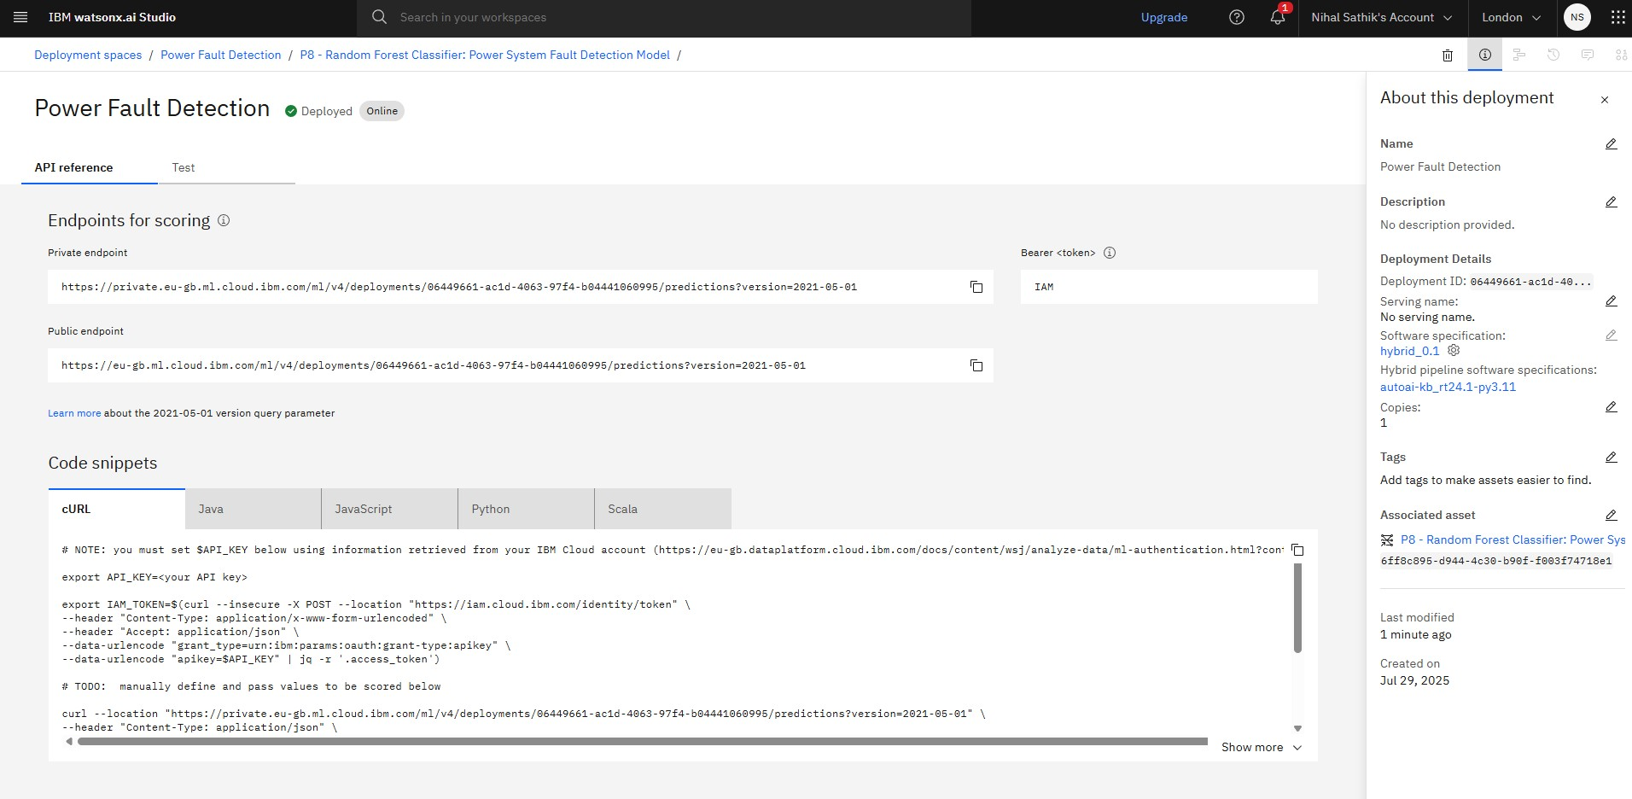
Result

Slide 13
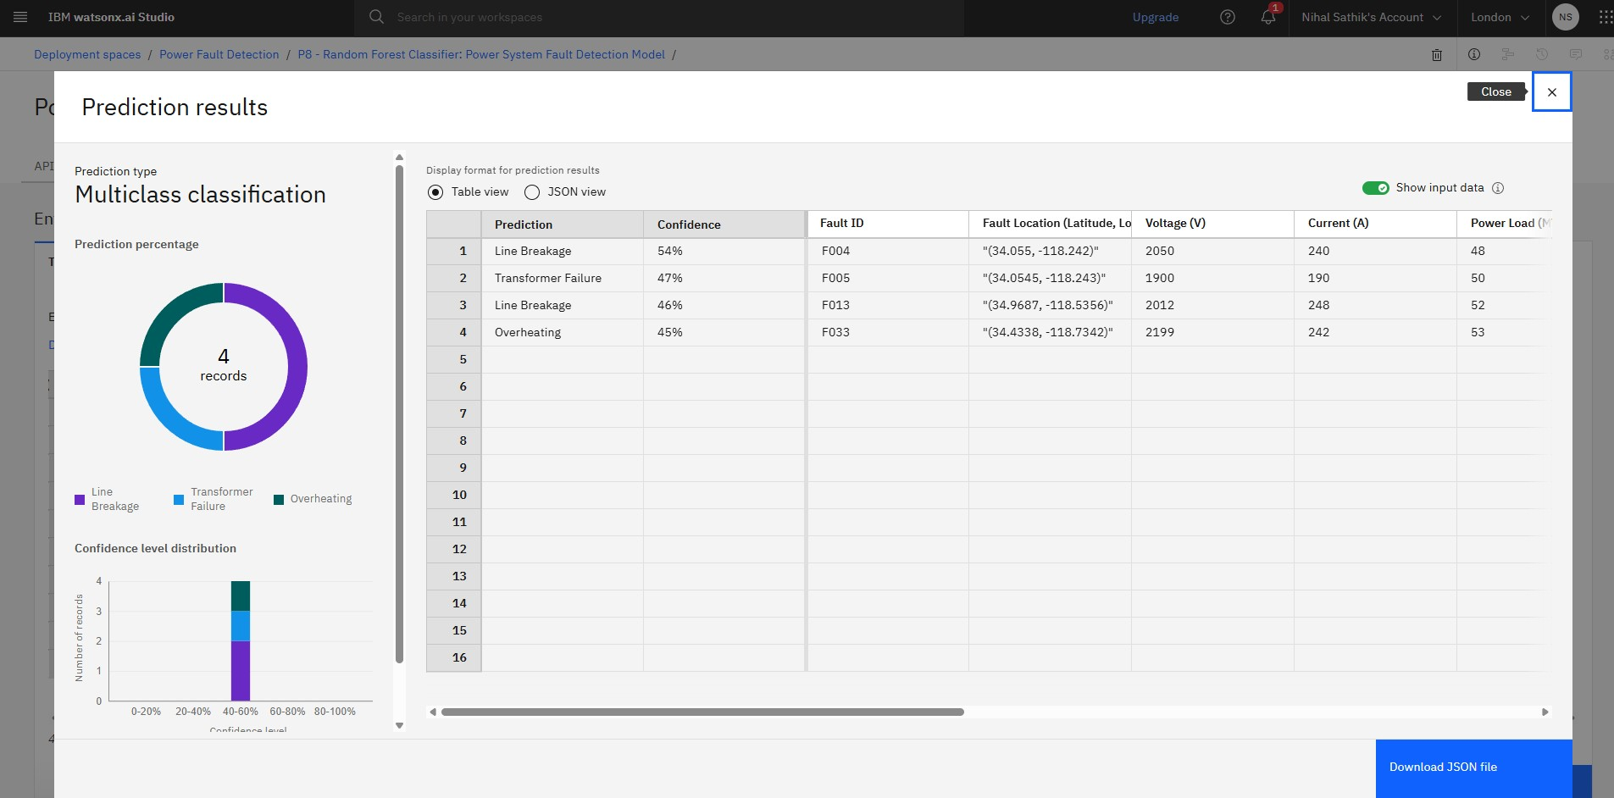
Result

Slide 14
Conclusion
The proposed AI-based solution delivers rapid, accurate identification of various faults using real-world electrical data.
Model deployment on IBM Cloud via Watsonx.ai Studio ensures scalability and accessibility.
Accurate fault classification can significantly improve grid reliability and response times.
Challenges included data quality, real-time integration, and model generalization.

Slide 15
Future scope
Incorporate additional electrical parameters (frequency, harmonics) to further refine fault classification.
Integrate real-time streaming analytics for live monitoring.
Expand to cover larger grid networks and new fault types.
Investigate alternative algorithms (Deep Learning, Ensemble techniques) for performance gains.
Explore edge computing for on-site, real-time fault detection.

Slide 16
References
Academic Papers on Fault Detection in Power Systems
Fault Detection and Classification in Electrical Power (MDPI, 2023)
A Machine Learning–Based Approach for Fault Detection in Power Systems (ETASR, 2023)
Kaggle dataset link
https://www.kaggle.com/datasets/ziya07/power-system-faults-dataset
IBM Cloud and Watsonx.ai Studio Documentation
IBM Cloud Docs (Official documentation)
IBM watsonx.ai documentation (IBM Docs)
scikit-learn and Python Machine Learning Resources
scikit-learn official documentation
Python for Machine Learning (GeeksforGeeks guide)

Slide 17
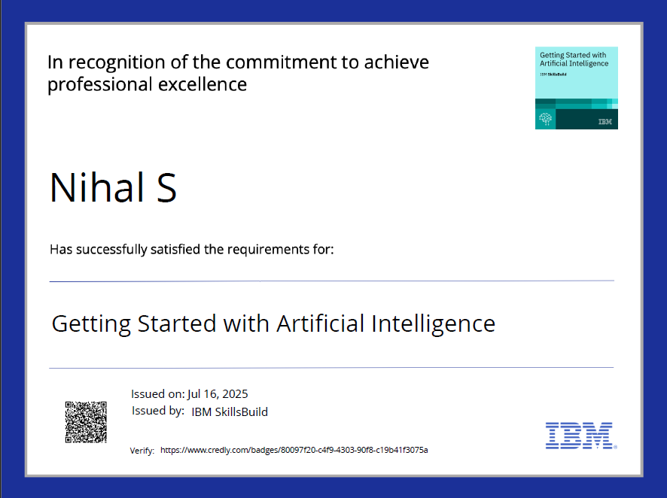
IBM Certifications

Slide 18
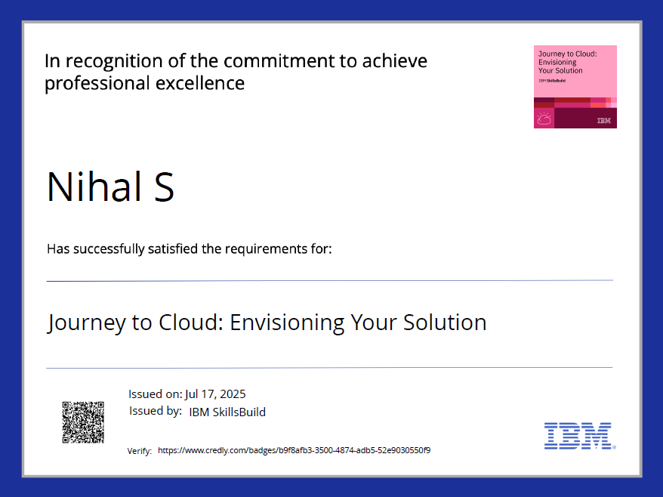
IBM Certifications

Slide 19
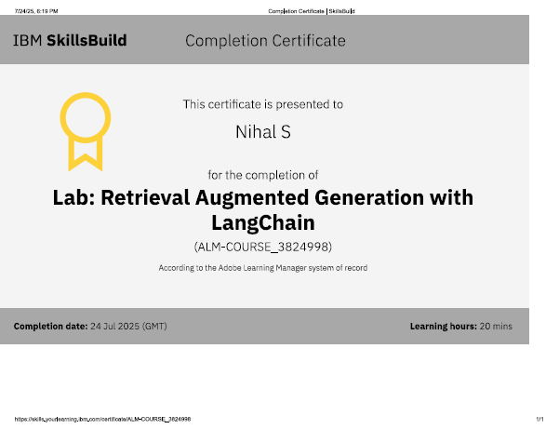
IBM Certifications

Slide 20
THANK YOU

